Slide 1

Automated meeting ROOM Booking system

Slide 2

Content
1. | Abstract
2. | Introduction
3. | Implementation
4. | Objective
5. | Analysis Of The project
6. | Flowchart
7. | Snapshots
8. | conclusion
9. | Future scope

Slide 3

Abstract
Automated Meeting Room Booking System

Slide 4
A contemporary approach to simplify the process of booking and managing meeting rooms inside an organization is the “Automated Meeting Room Booking System” initiative.
The aim of this project is to allow users to quickly reserve available rooms using the system, which cuts down on the time spent looking for suitable spaces. The automated addition of scheduled meetings to attendees’ calendars is made possible via integration with calendars and scheduling applications, reducing scheduling conflicts.
The technology gathers information on room usage, assisting businesses in making data-driven decisions to maximize their meeting rooms.
AUTOMATED MEETING ROOM BOOKING SYSTEM

Slide 5
INTRODUCTION
Automated meeting room booking system is a centralized booking system that organizes and streamlines the process of coordinating meetings and reserving rooms and space for those meetings.
It is an advanced solution that automates the procedure of booking a meeting room in a company allowing the employees can search and book a meeting room based on their requirements.
AUTOMATED MEETING ROOM BOOKING SYSTEM

Slide 6


implementation
FRONTEND
HTML
CSS
JavaScript
BACKEND
JDBC
MySQL
AUTOMATED MEETING ROOM BOOKING SYSTEM

Slide 7



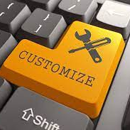




objective
REAL TIME AVAILABILITY
QUICK BOOKING
RESOURCE INTEGRATION
CUSTOMIZATION
NOTIFICATION
SYSTEM
MOBILE ACCESS
SECURITY AND COST CONTROL
COST
OPTIMIZATION
AUTOMATED MEETING ROOM BOOKING SYSTEM

Slide 8
Analysis
Automated Meeting Room Booking System

Slide 9

Key components
Meeting room management
User management
Users are categorized into three roles:
Admin, Manager, Member
User data includes name, email, phone, credits, and role.
Admins can create and configure meeting rooms.
Meeting room data includes a unique name, seating capacity, ratings and etc.
1
2
Booking information
Meeting management
Users can search for available meetings rooms based on date, start time, and end time.
Meetings are tracked, and meeting room booking information is associated with each meeting.
3
4
AUTOMATED MEETING ROOM BOOKING SYSTEM

Slide 10
architecture
Responsible for database interactions.
Contains methods for querying and updating the database.
Uses JDBC to connect to the database.
Data access layer (DAO)
Contains the core business logic of the application.
Implements functions like searching for available meeting rooms and booking meeting rooms.
Interacts with the DAO for data access.
Business logic layer (Service)
Handles user interactions.
Calls business logic layer functions based on user input.
Provides the interface for users to search and book meeting rooms.
User interface layer (controller)
AUTOMATED MEETING ROOM BOOKING SYSTEM

Slide 11

The database includes tables for Users, MeetingRoom, BookingInformation and Meeting.
User roles (Admin, Manager, Member) are used to control access to various features.
Foreign keys establish relationships between tables, ensuring data integrity. SQL Queries.
DATABASE DESIGN
AUTOMATED MEETING ROOM BOOKING SYSTEM

Slide 12
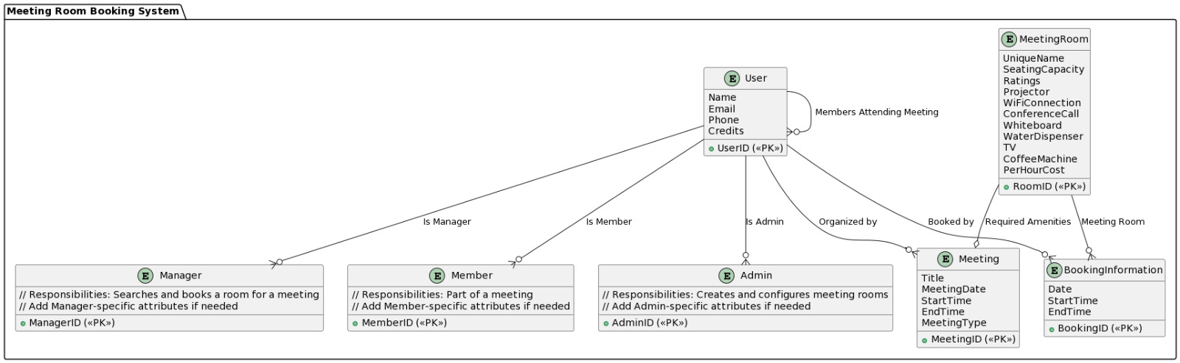
E-R DIAGRAM
AUTOMATED MEETING ROOM BOOKING SYSTEM

Slide 13
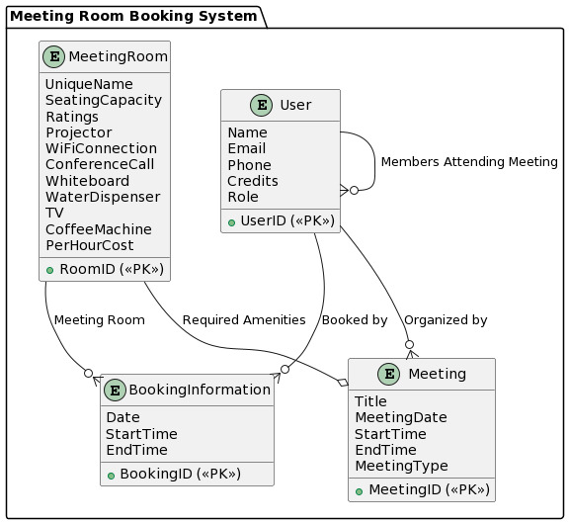
E-R DIAGRAM
(Contd..)
AUTOMATED MEETING ROOM BOOKING SYSTEM

Slide 14
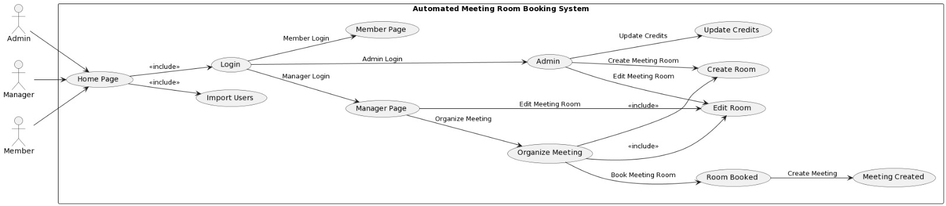
UML DIAGRAM
AUTOMATED MEETING ROOM BOOKING SYSTEM

Slide 15
flowchart
Automated Meeting Room Booking System

Slide 16
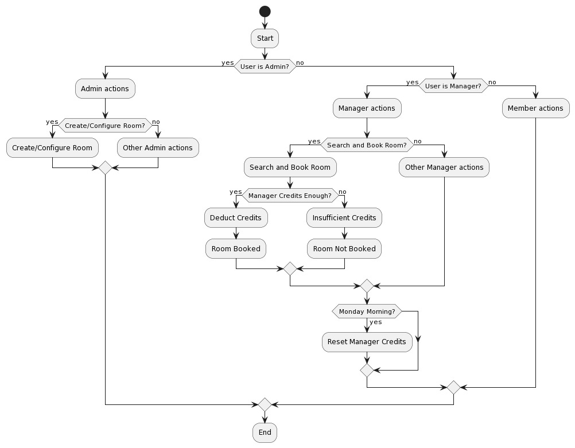
AUTOMATED MEETING ROOM BOOKING SYSTEM

Slide 17
snapshots
Automated Meeting Room Booking System

Slide 18
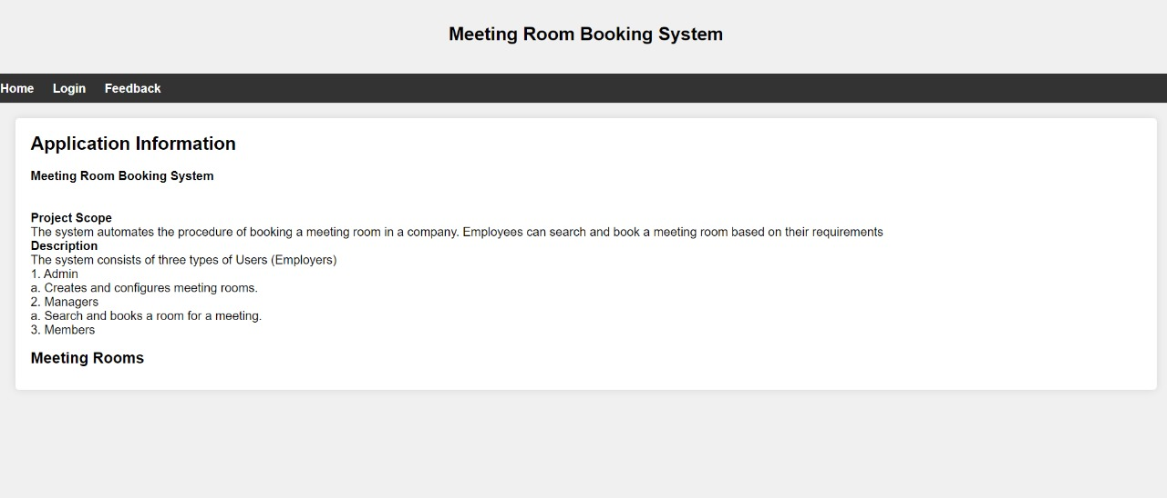

Slide 19
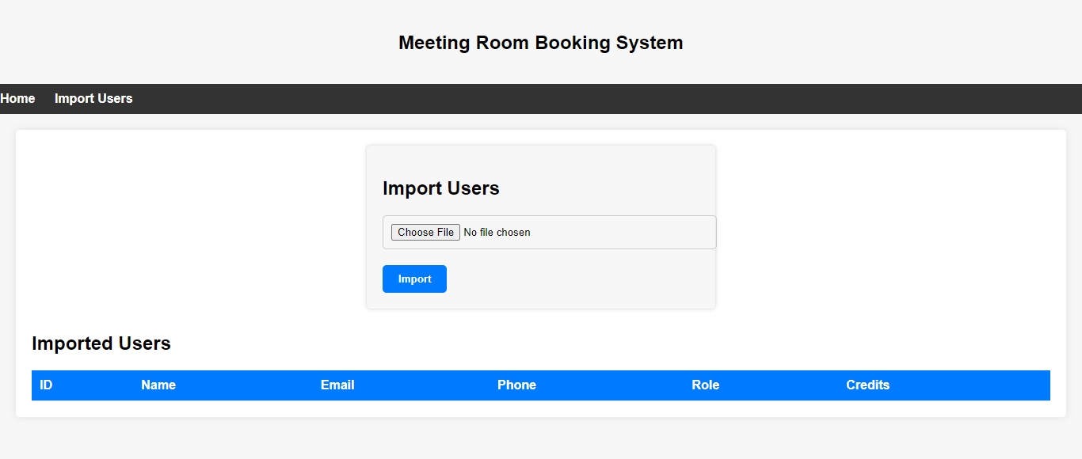

Slide 20
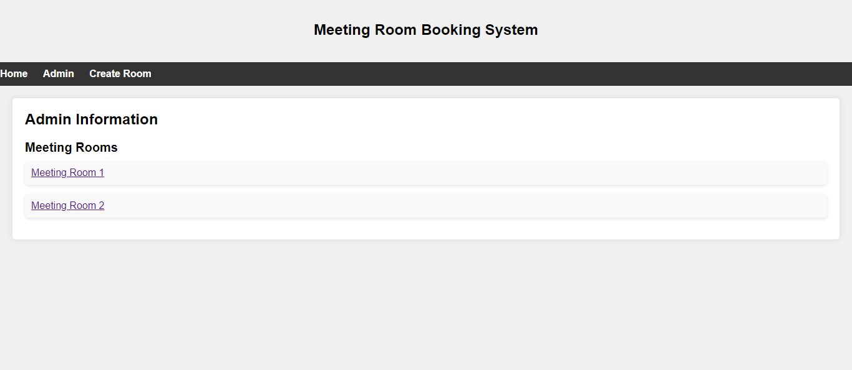

Slide 21
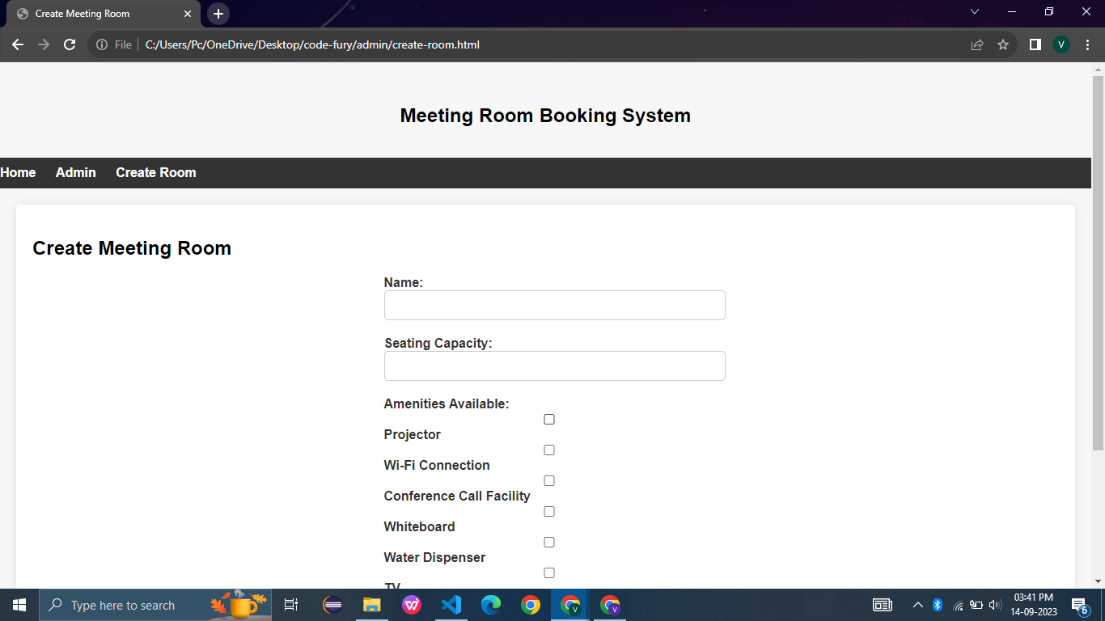

Slide 22
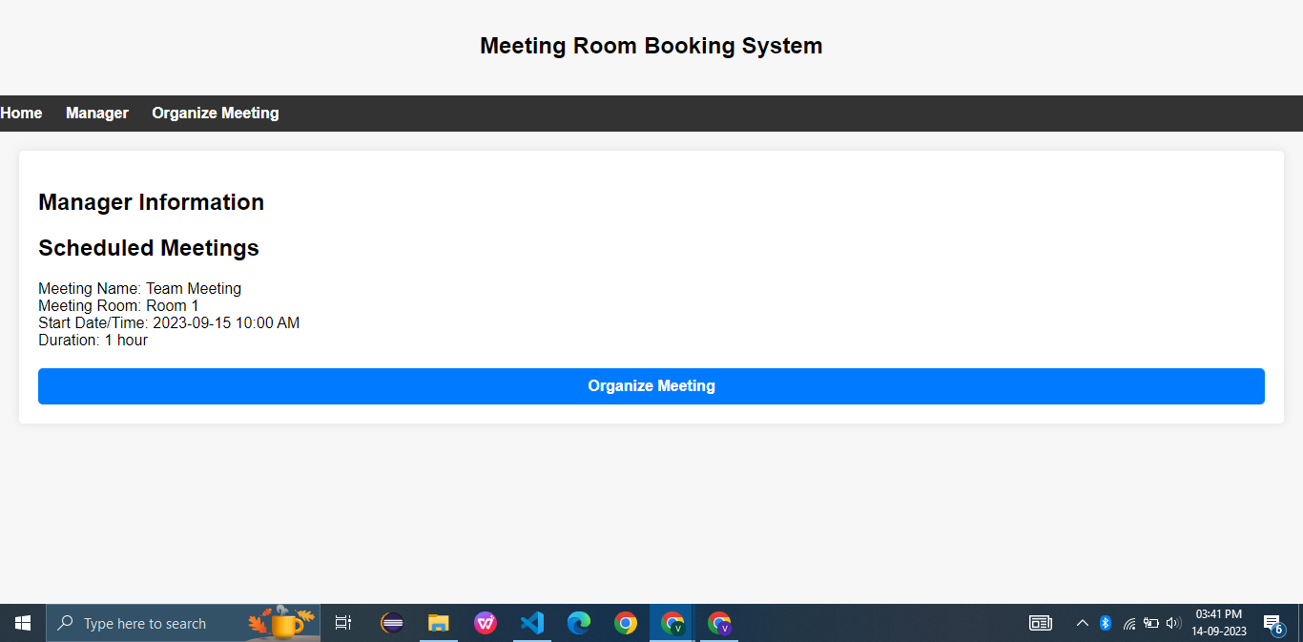

Slide 23
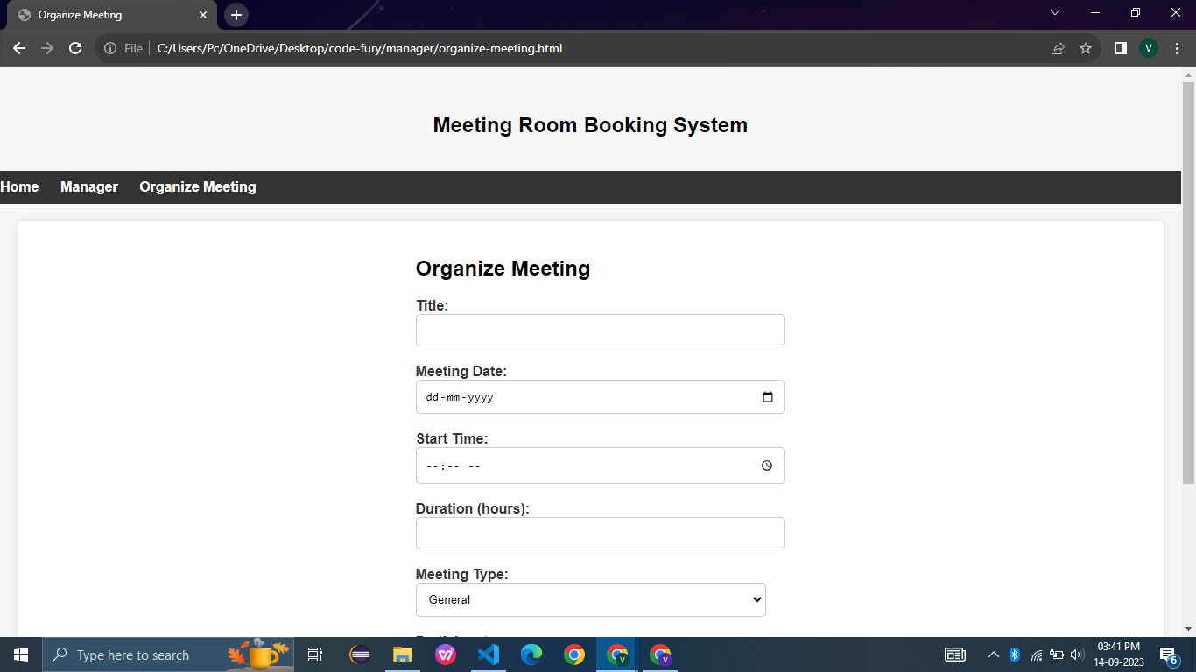

Slide 24
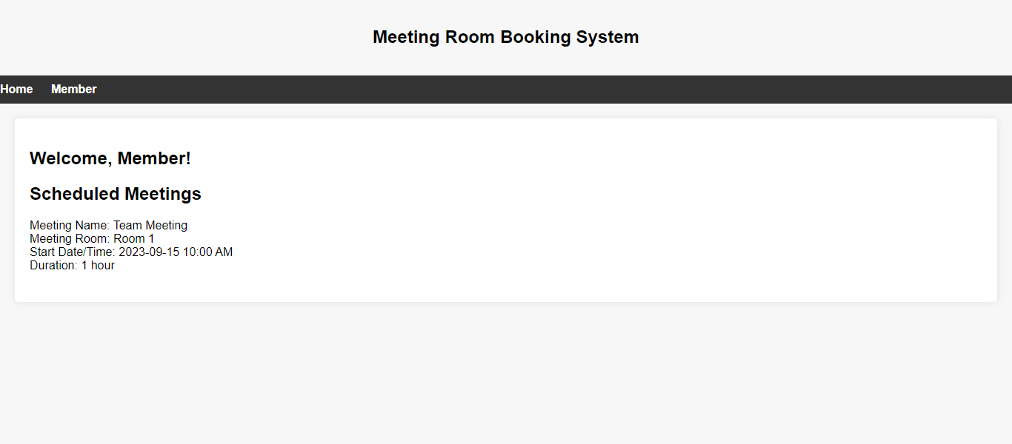

Slide 25
conclusion
The Meeting Room Allotment System represents a versatile and valuable tool for efficiently managing meeting rooms, enhancing collaboration, and streamlining the booking process within an organization. This project has successfully addressed the fundamental requirements for user roles, room management, booking functionalities, and database integration.
This system represents a vital tool in fostering a productive and collaborative work environment, and its future enhancements will contribute to the overall efficiency and effectiveness of the organization it serves.
AUTOMATED MEETING ROOM BOOKING SYSTEM

Slide 26
Future scope
Implement a real-time availability checker to show immediate room availability based on user-selected criteria.
Integrate with popular room scheduling and calendar systems like Microsoft Outlook or Google Calendar.
Send automated reminders and notifications to meeting attendees.
Allow attendees to provide feedback on meetings, presenters, and meeting rooms. Explore chatbots or visual assistants to handle user queries and room bookings.
AUTOMATED MEETING ROOM BOOKING SYSTEM

Slide 27

This Photo by Unknown Author is licensed under CC BY
- HADY KHAN
- HARSH SRIVASTAVA
- JANAVI S
-NIKHIL
- PRAGATI BISEN
- RITVIKA MALVIYA
- VRUSHALI
- YASHMITHA

